Slide 1
Osher Lifelong Learning Institute, June 2026
Contemporary Economic Policy
University of Minnesota
Host: Geoffrey Woglom, Director
National Economic Education Delegation

Slide 2
Course Schedule
Contemporary Economic Policy
  Week 1 (6/3): Economic Update & Changes at the Fed, Geoffrey Woglom, Amherst College
  Week 2 (6/10): Federal Debt and Deficits, Kathryn Wilson Kent State University
  Week 3 (6/17): Banking Crises, Gerard Caprio, Williams College
  Week 4 (6/24): Saving Social Security, Geoffrey Woglom, Amherst College

Slide 3
Submitting Questions
Submit questions in the chat or by raising your digital hand. We will do a verbal Q&A once the material has been presented.
Slides will be available from the NEED website tonight or tomorrow https://needecon.org/delivered_presentations.php.

Slide 4
Banking Crises: A Hardy Perennial
Gerard Caprio
William Brough Professor of Economics, Emeritus
Williams College

Slide 5
Outline
Why Crises Matter…and Why So Many
Why Finance is Fragile
How Finance Gets Riskier
Regulating to mitigate crises
Lessons from past crises
Notes:
Will not cover a Separate topic -- How to deal with crises once one has started -- separate talk!

Slide 6
Why crises matter
Impact on economy
  Loss of output, jobs, income
  When debt/GDP high, reduce borrower net worth, cutting investment and consumption.
Impact on people: hurt the poor
  E.g., Dominican Republic, Argentina, Greece…
Frequency: crises keep recurring
Contagion: from one market, sector or economy to others
Notes:
Bank dependent firms and households suffer first, then can spread
Not just a transfer of money -- Marginal thinking won't work when transferring a substantial share of GDP!
Contagion -- Mexico's crisis of 1994 became the Tequila Crisis in L.A.
Thailand morphed into the East Asian Crisis in 1997
The US in 2008 was the trigger for the GFC (not the cause!!)

Slide 7
Why Crises Matter, cont.
Fallout:
  Public and private debt levels rise, sometimes to unsustainable levels
  Other reform efforts may be slowed (e.g. banks lobby for suspension of climate regulations)
Lessons: crises often reveal weaknesses of financial system – who is ‘swimming naked’ (Warren Buffet)
And crises can start outside the financial system
  Greece, Doom Loop

Slide 8
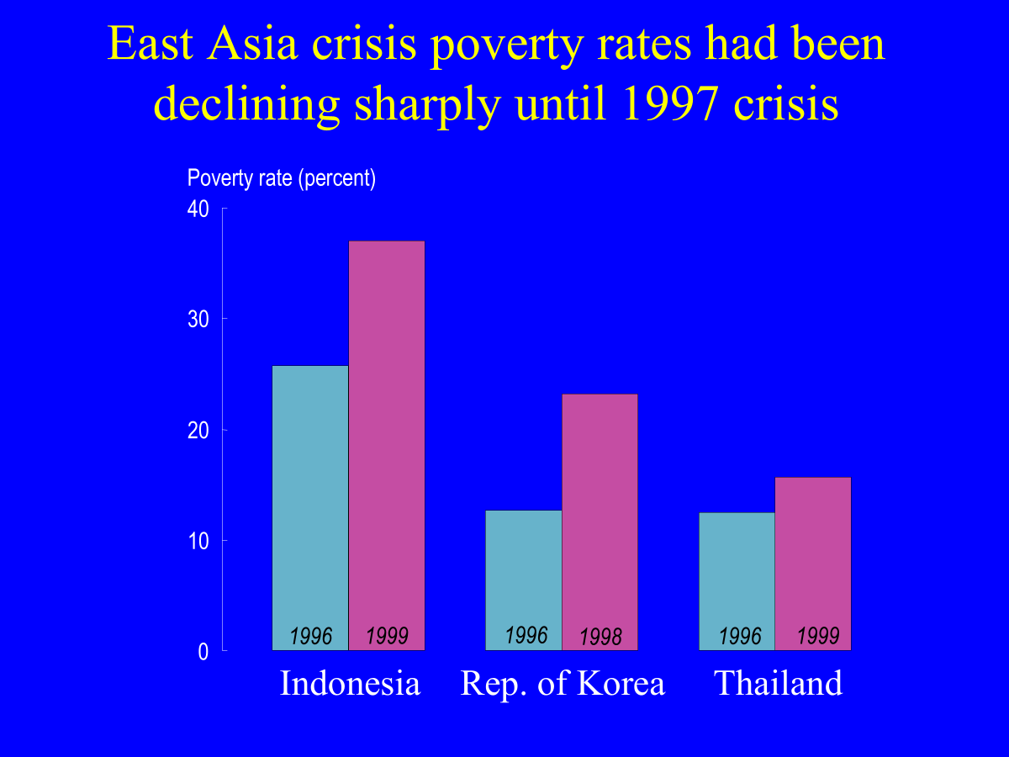

Slide 9
What is a Financial Crisis?
IMF: A run on the currency, or on the banking system. The payments function is impaired
World Bank: When the system is insolvent
  Functions of finance impaired, development is set back
Fed view: Financial instability occurs when problems (or concerns about potential problems) within institutions, markets, payments systems, or the financial system in general significantly impair the supply of credit intermediation services – impacts economic activity.
When ‘the return of your money is more important than the return on your money.’ Will Rogers
Notes:
What are the 5 functions of finance?
Mobilize S, Allocate, Monitor, Facilitate risk management, and make payments.

Slide 10
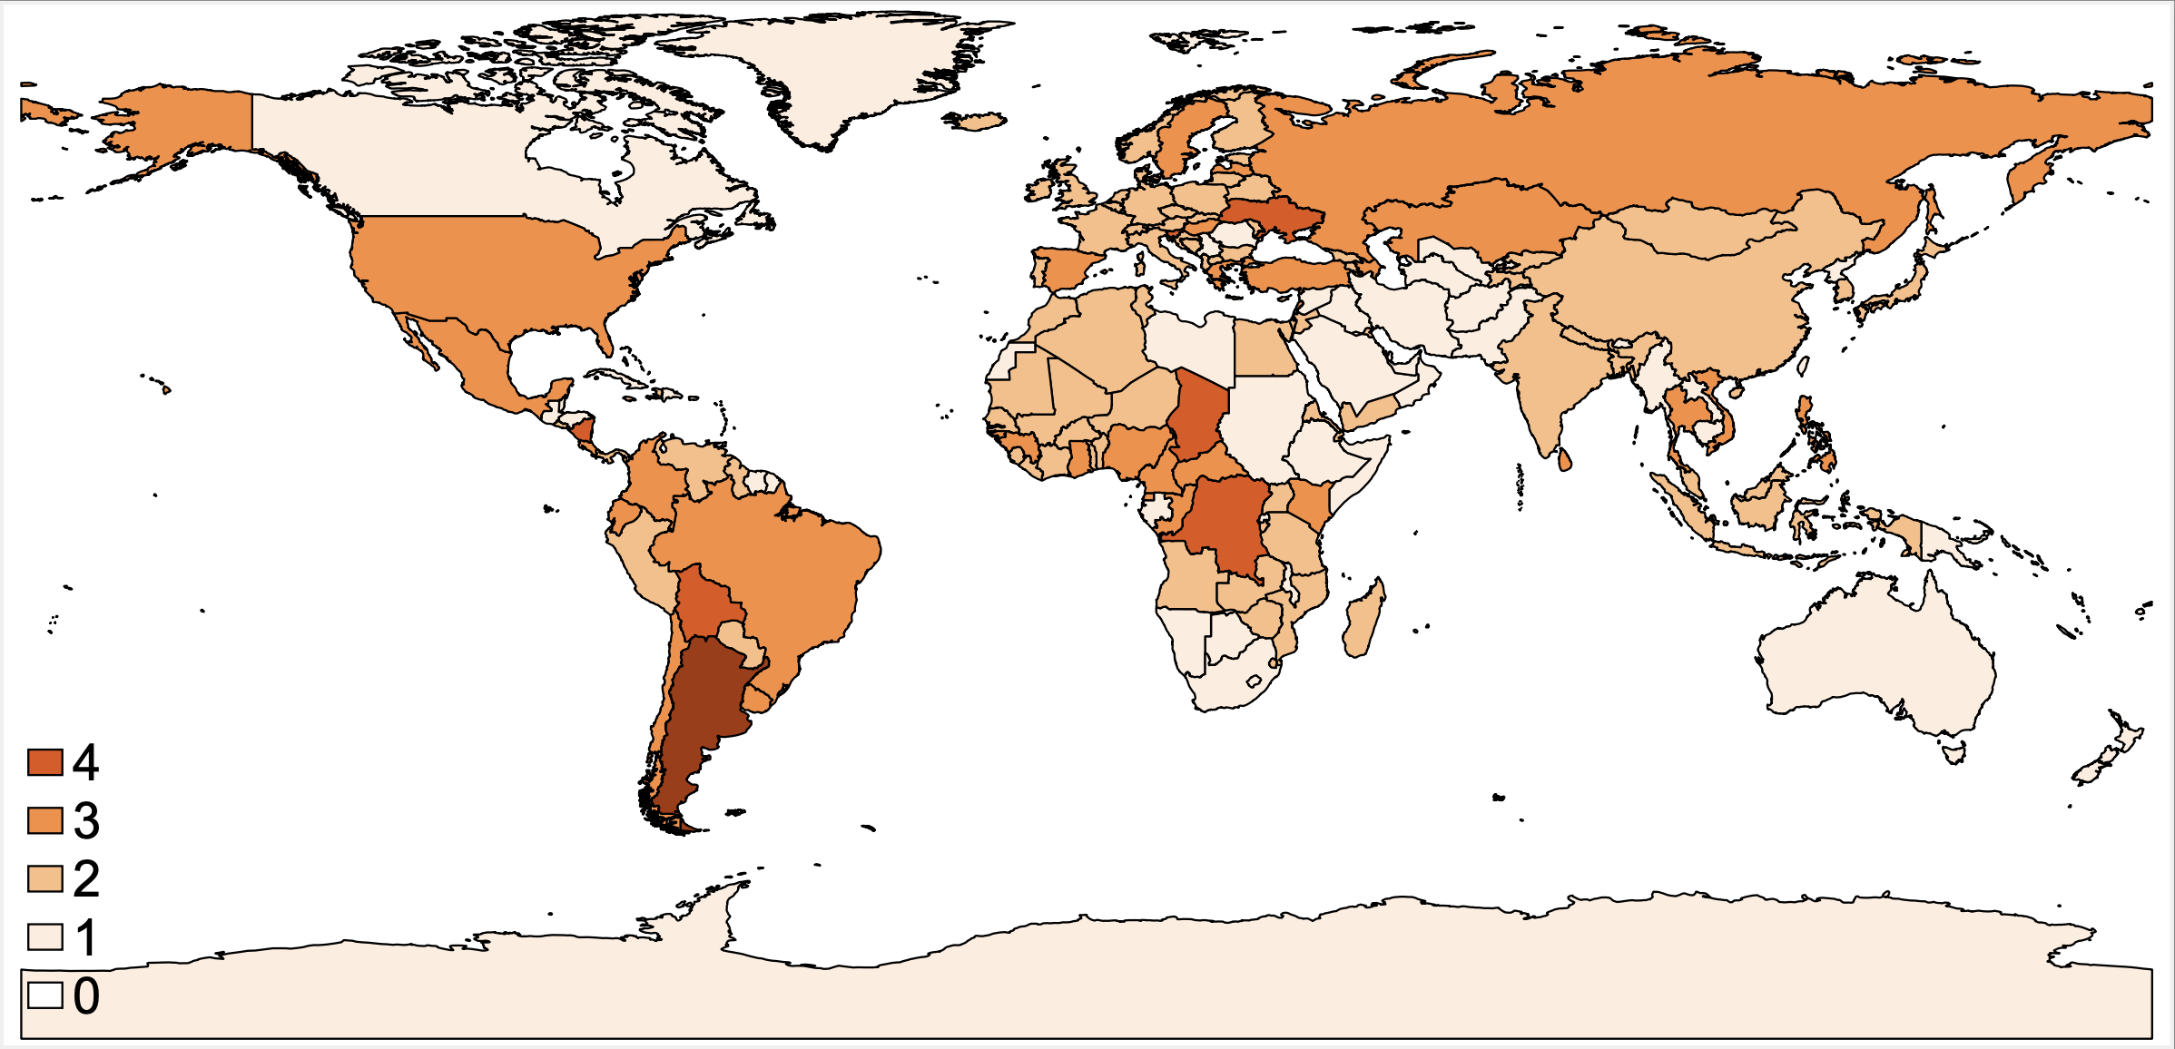
Frequency of Systemic Crises, 1970-2024
Notes:
Laeven and Valencia, forthcoming

Slide 11
Why So Many Crises?
Regulation is difficult:
  CEO adage and information
Regulators might lack the tools, skills, incentives (SVB!)
Private interest view – regulators can be influenced by regulatees (SVB - FRBSF?)
Even when regulators are trying to improve social welfare, information problems affect them too
Notes:
Who can explain why Silicon Valley Bank failed in March 2023? Relevance for other countries? Supervisors sitting on their hands.

Slide 12
Why So Many Crises II?
International coordination of financial regulation (e.g. the Basel Committee) might have made it worse!
  With each new version of the Basel Approach, regulation is ever more complex
  Complexity leaves more room for interpretation and evasion, harder to monitor.

Slide 13
Why So Many Crises, III
Compensation can create spectacular rewards for risk taking
  Result: more risks
Broader point: finance changes all the time
  Technology and regulations change
  "If you entrench yourself behind strong fortifications, you compel the enemy to seek a solution elsewhere.” von Clausewitz
So, regulation is a dynamic game
  Therefore regulation has to adapt!
Notes:
Especially with limited liability!

Slide 14
Why finance is fragile
Asymmetric and heterogeneous information
Individuals not fully rational in assessing risk
  Framing affects decision –Kahneman and Tversky
  A: you win $1000 with certainty
B: 50% chance of $2500, or 0
C-- lose 1000 with certainty or
D-- lose 2500 with 50% probability
A, D are the most popular choices – risk averse and risk loving alternatives
Notes:
Which is more popular choice? A
Of C ad D? D! So much for rationality

Slide 15
Public Health Example
Imagine the outbreak of an unusual disease, expected to kill 600 people. Pick a public health programs to combat it:
Program A: Save 200 lives, p = 1
Program B: Save 600 lives, p = .33
Save 0 lives, p = .67
Program C: 400 people die, p = 1
Program D: 0 die p = .33
600 die p = .67
(Note: A=C, B = D)
Notes:
A and D yet again are the most popular. But A=C, B= D, just stated differently.
In finance, the way choices are posed, with same data, influences choices (stocks v bonds). Khanneman and Tversky's contribution, among others

Slide 16
Why Finance is Fragile II
Excessively weight recent experience (myopia)
Individuals trade on noise (‘animal spirits’) rather than on fundamentals
Exhibit positive feedback (buy when prices are high, sell when prices are low)
Finance depends on information and trust: both subject to change. Shocks happen!

Slide 17
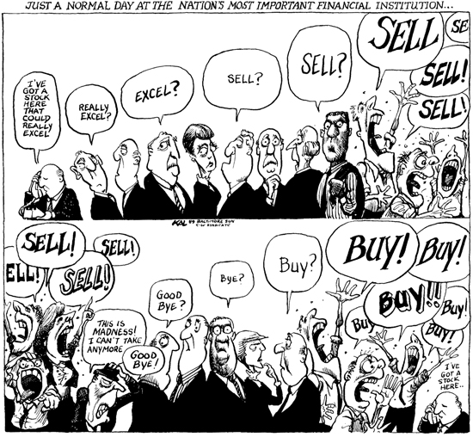
Positive Feedback in Action

Slide 18
La Plus ca Change…
  “When the rest of the world are mad, we must imitate them in some measure.” John Martin, Martin’s Bank, 1720 – his bank bought South Sea Company stock in that famous bubble.
  “When the music stops, in terms of liquidity, things will be complicated. But as long as the music is playing, you’ve got to get up and dance. We’re still dancing.” Chuck Prince, ex-CEO, Citibank, July 2007, right before the market froze in August, ‘07
But the music already had stopped…mortgage default rates had started rising the previous winter.
Notes:
Watch The Big Short and Inside Job for details

Slide 19
Banking is fragile
Demandable debt, term transformation risky
  No runs on mutual funds except due to fraud or theft
Leverage: Other people’s money
Banks are opaque
Sensitive dependence on initial conditions
  Banks = a given set of assets, skills, information and existing regulations and markets.
  When the environment changes:
    Value of assets, skills and information impacted
    Mistakes almost inevitable
Notes:
What country has the largest Islamic Banking system in the world, ranked by the % of assets in Islamic banks relative to those in the rest of the financial system?
N.B. one reason for the tremors in the financial crisis when Trump first announced his tariff plan was that there were several large hedge funds levered 50 to 100 to 1, so slight losses wiped them out. Hence they had to sell the liquid part of their portfolio, which was US Treasuries. And other funds knew this so they dumped treasuries as well.

Slide 20
Finance gets riskier when:
Information problems rise
Economic volatility rises, policy regimes change
Rewards rise -- macro booms
Markets are small or shrink
  Or change dramatically (e.g., new era)
Regulations change
When financial reforms are poorly sequenced
  Politicians like cheap, easy, quick reforms
When leverage is high/rising sharply

Slide 21
Finance is Riskier in Emerging Markets
Greater information problems
Generally smaller size of market
  Smaller markets ⇒ more real, nominal, & financial volatility
Regime shifts – generally bigger swings in economic policy, perhaps due to bigger shocks
Domination of banking and debt finance, usually short term ⇒ firm’s financing is riskier!
Poorly sequenced reforms
Notes:
Small markets implies more concentrated risks.
Poor sequencing in Mexican Crisis (privatization before attention to prudential regulation), same in Iceland in 2000s. Thailand (international financial center before regulation developed)
Trump is creating a huge regime shift!
Examples: interest rate deregulation in 1970s-90s in most countries, bank privatization in Mexico, etc.

Slide 22
From Good Bankers to Bad Bankers
Technical mismanagement. Most popular mistakes:
  Mismatched risk: too much term transformation or FX risk
  Concentrated risk: lend too much to single or (cor-)related borrowers
Cosmetic mismanagement
  Evergreening: “All new loans are good, as have not had time to go bad yet.”
  Upside down income statement:
  Normal P&L statement: start with revenues (interest and fees received), subtract costs (interest paid and other costs), pay taxes, and decide how much to retain, paying the rest as dividends.
  Fake P&L: start with the dividends needed to pay to avoid suspicion, then invent the other numbers, such as by showing as interest received interest due but not paid
Notes:
Aris deJuan
applies at the individual banker level and to institutions as well -- CEO participates in the cover up!

Slide 23
Good Bankers to Bad, II
Desperate mismanagement
  Taking very high risks with depositors’ funds is legal (though literally gambling is not).
  Pay high rates of return to get more deposits, make more high-risk loans or investments, and hope to survive (Ponzi Finance, or almost a Ponzi Scheme)
Fraud, flight or other exit: stealing money from the bank and leave the country, or committing suicide the final options. Or jail
Texas S&Ls’ example

Slide 24
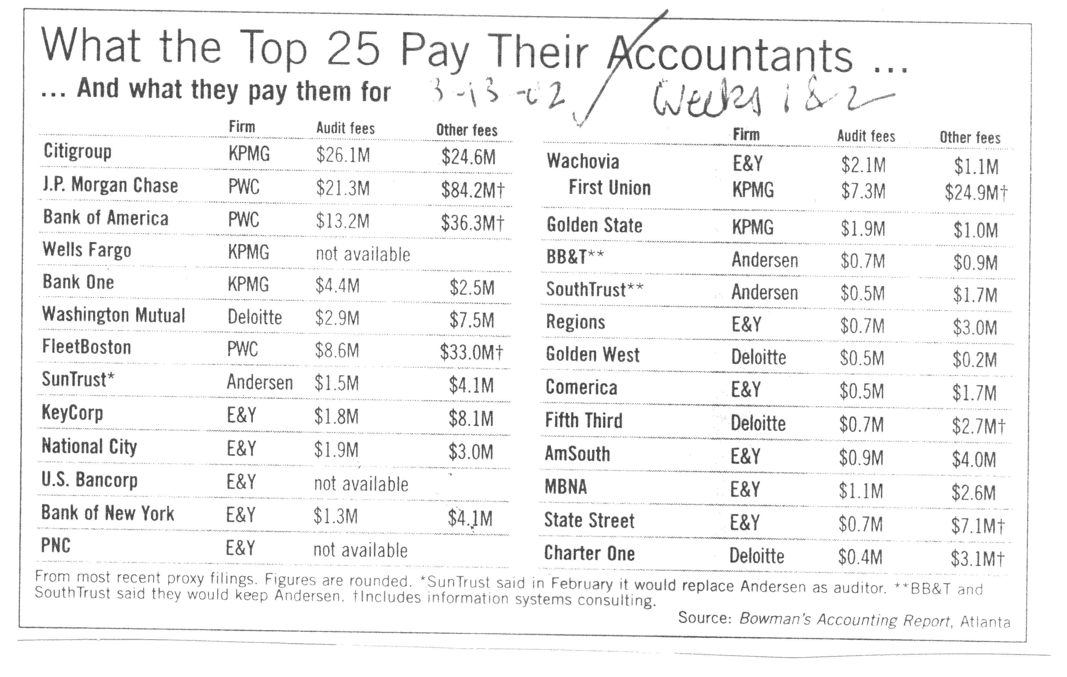
Disinformation Pays Well: auditors’ conflict of interest when they get big consulting fees, in effect a bribe for a positive audit

Slide 25
In Sum: Causes of Crises
Birds’ Eye View
Excess leverage, mismatched risk, concentrated risk
Macro cycles – euphoria, then panic
New Era (change in relative prices, technology, ‘this time is different’ thinking)
Information problems conceal vulnerabilities until they become too big to hide
Complacent, compliant or overwhelmed regulators
Notes:
My fourth tip is that something always blows when markets glow red. Whether it’s LTCM or Northern Rock or a US regional bank or Archegos — wild swings in prices plus leverage plus too-good-to-be-trueness equals ka-boom.

Slide 26
Crisis Prevention:
Or At Least, Crisis Mitigation
“It ain’t what you don’t know that gets you into trouble. It’s what you do know that ain’t so” Mark Twain

Slide 27
Why Doesn’t Regulation Prevent Crises?
The economics is complex.
The legal, accounting, and political components are complex.
And, all of the ingredients are changing
  Financiers innovate.
  Lobbyists lobby.
  Political constituencies gain and lose power.
Complexity and changing ingredients lead to mistakes.

Slide 28
But, its not just complexity
Iceland, Ireland were not hard to see coming.
NINJA loans (U.S.) were not a secret.
Financial regulators too often choose policies in the best interests of the financial services industry.
Central problem of financial regulation: getting regulators to act in society’s interest.

Slide 29
Is it regulatory capture?
The revolving door.
Examples:
  NY Federal Reserve Presidents
  Rubin, Paulson, others at Treasury
  SEC executives
  HBOS CEO, ….
But many just doing their best… just like with sports referees?

Slide 30
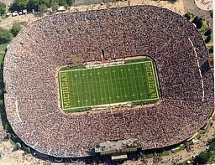
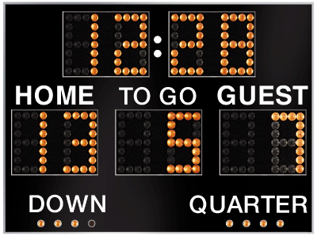
Why is there a home team advantage?

Slide 31
Is it human nature?
Officials are not corrupt; they are human, and sub-consciously please the home crowd.
  Officials do not reluctantly change their stated views
  They genuinely adopt the crowd’s view
  Conformity changes their actual perceptions
The financial services industry has the home field advantage.

Slide 32
Why might regulators be biased?
It could be:
  Regulatory capture
  Psychological conformity
But, this only explains their incentives.
What accounts for their ability to act on these biased incentives?

Slide 33
Why did it happen?
Why didn’t the public compel the regulators to work in society’s interest?
It can’t…
  It can’t obtain an informed, expert, and independent assessment of regulation.
  Therefore, it can’t even begin to govern regulators effectively.
  Regulators have a monopoly on the information and expertise, and accountability is flawed

Slide 34
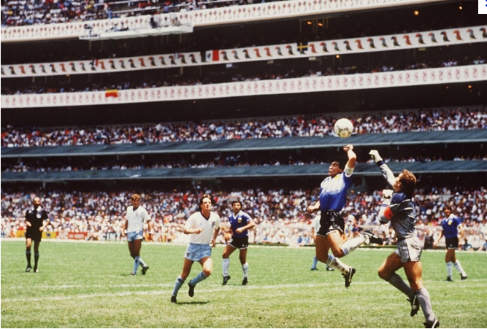
The Guardians of Finance
Making Regulators Work for Us
James R. Barth
Gerard Caprio, Jr.
Ross Levine

Slide 35
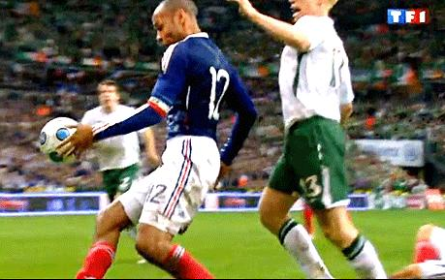
The Guardians of Finance
Making Regulators Work for Us
James R. Barth
Gerard Caprio, Jr.
Ross Levine

Slide 36
Possible remedies
Better incentives for bankers
  Liability limits? Deferred bonuses?
Better incentives for regulators
  Independent monitoring group -- instant replay
Simpler rules to permit greater accountability

Slide 37
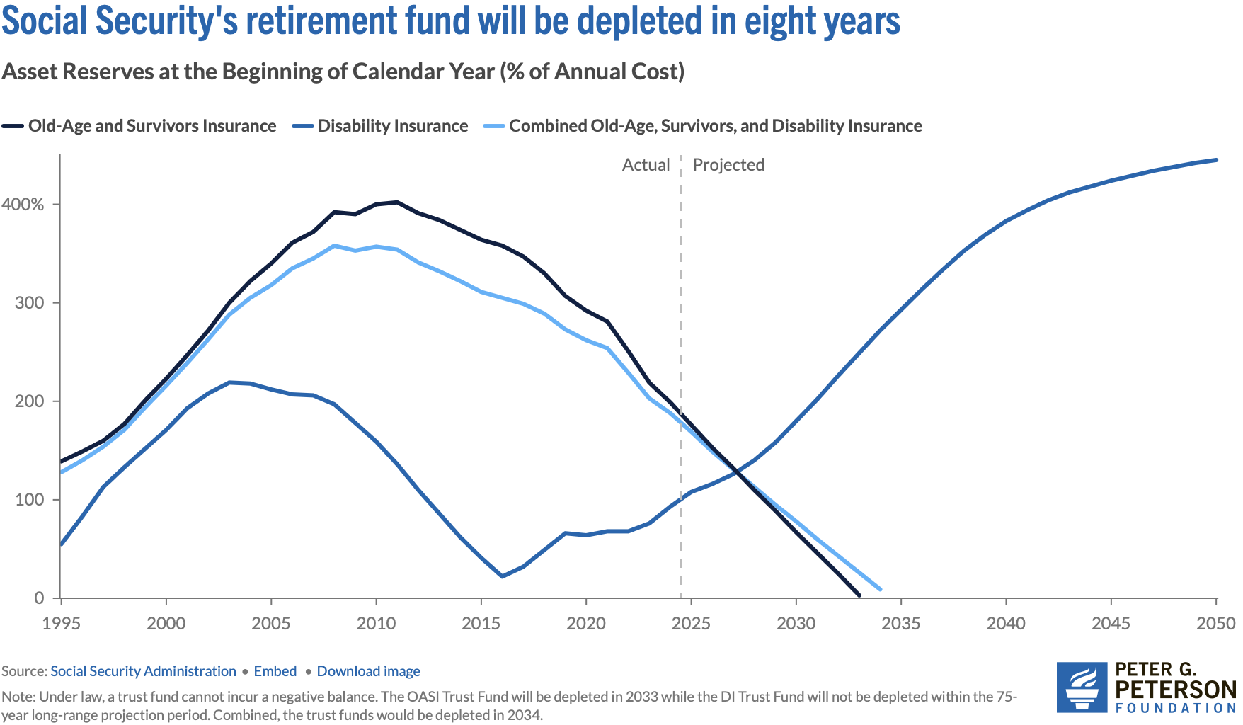
Next: Saving Social Security

Slide 38
Thank you!
Any Questions?
Gerard Caprio, Ph.D.
gcaprio@williams.edu
Contact NEED: info@NEEDEcon.org
Become a Friend of NEED: www.NEEDEcon.org/friend.php

